Slide 1


Atlantis Feature Store Activity and Lineage Page Development
2023
A glimpse into my summer of personal growth and skill building as a TDP intern
Sai Neelanjana / Systems and DevOps Engineering Intern
August 9, 2023

Slide 2

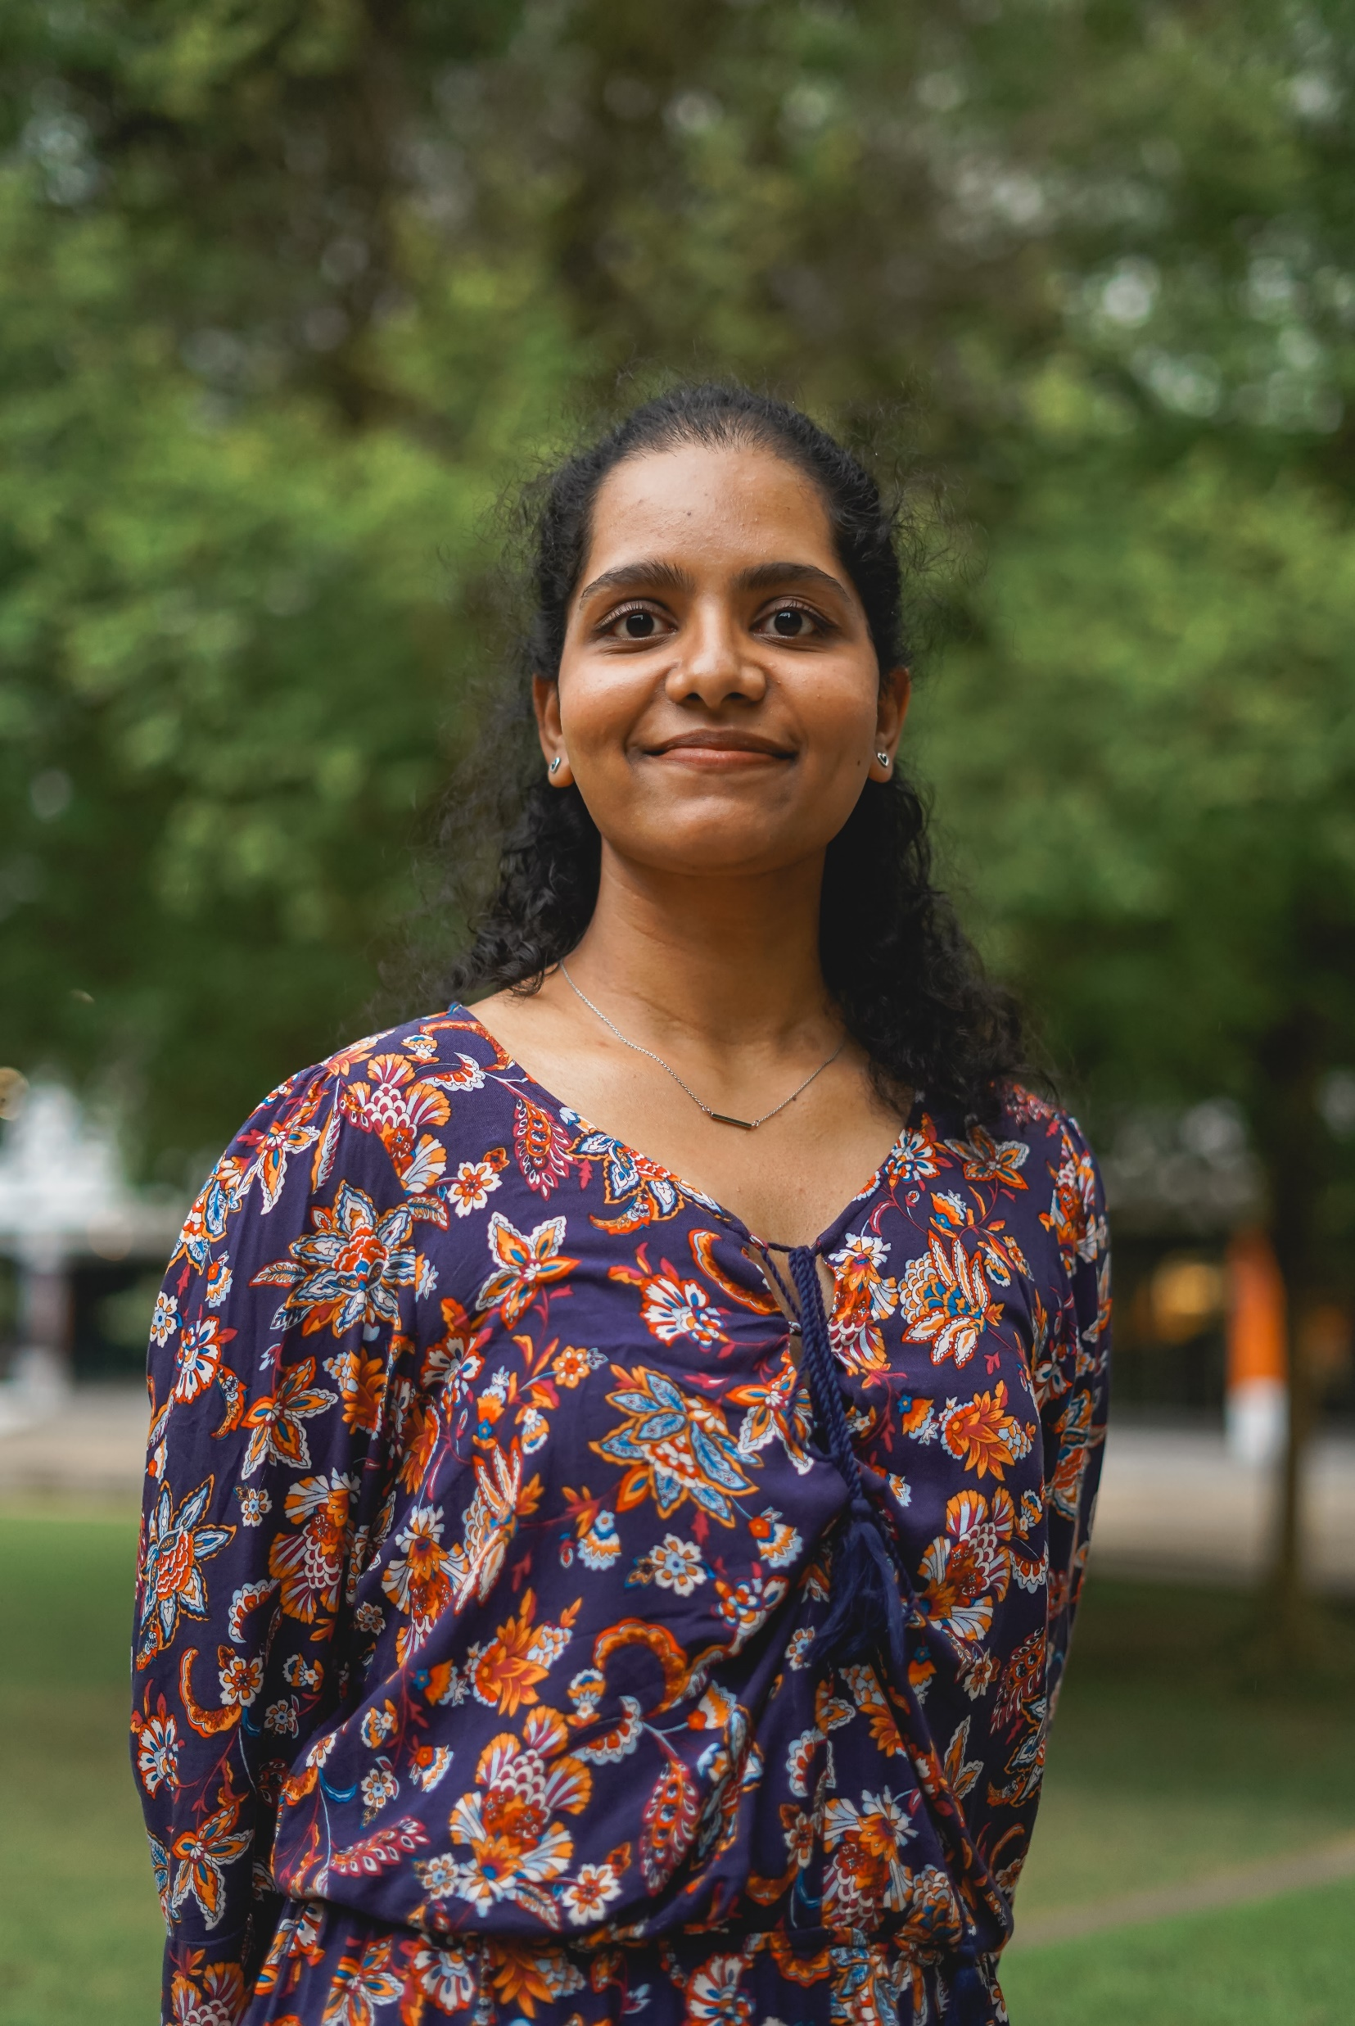
Education:
University of Texas at Austin
B.S. in Computer Science
Minor in Business
Previous Experience:
AT&T Technology Academy – TBM
Research/Development Intern at Vanguard College Prep
UT Austin Freshman Research Initiative – Energy Analytics | Conoco Phillips
Hometown:
Coppell, TX
Hyderabad, India
Leadership Experience:
Publicity Chair - Women in Computer Science (WiCS) @ UT Austin
Hobbies and Interests:
Photography
Travel
Sai Neelanjana
System and DevOps Engineering Intern
Atlantis Feature Store Team

Slide 3


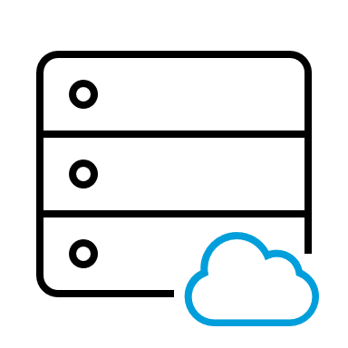


Introducing the Atlantis Team
Also received help from the team with
UI Development
Backend API support
Himanshu Tiwari
Principal – Big Data Software Engineer
Business Partner | Mentor | Point of Contact
Krishna Pandraju
Senior – Big Data Software Engineer
Backend Data Engineer Support
“Centralized repository for storing, updating, retrieving, and sharing features used in machine learning models across different projects”

Slide 4
Project Statement:
How can we design an Activity and Lineage Page for the Atlantis Feature Store to provide users with a comprehensive view of feature set manipulation and historical information?
Background
Atlantis Feature Store is a critical component enabling teams to access and share AI/ML features. However, the lack of an activity and lineage page made it challenging for users to:
track feature set changes
understand who is using their data
find popular feature sets
identify the origin of feature sets
understand overall data flow
Findings
View activity history
Understand who made specific changes
Ensure data quality through the logs
Gain insight into how the data evolves over time
Search and filtering capabilities help manage large volumes of activity logs
Conclusion
Enhances data transparency and traceability
Fosters data-driven culture
Enables more informed decision making and accountability

Slide 5





Project Timeline
1. Ideation
Brainstorming product design ideas
5. Deployment and Testing
Product deployed to stage environment. Updated with feedback
3. UI Development
Started developing product using Angular framework
Week 1
Week 2
Week 3
Week 4
Week 5
Week 6
Week 7
Week 8
Week 9
2. Prototyping
Designed high-level prototypes in Figma
4. API Integration
Called APIs and integrated responses to display in UI

Slide 6

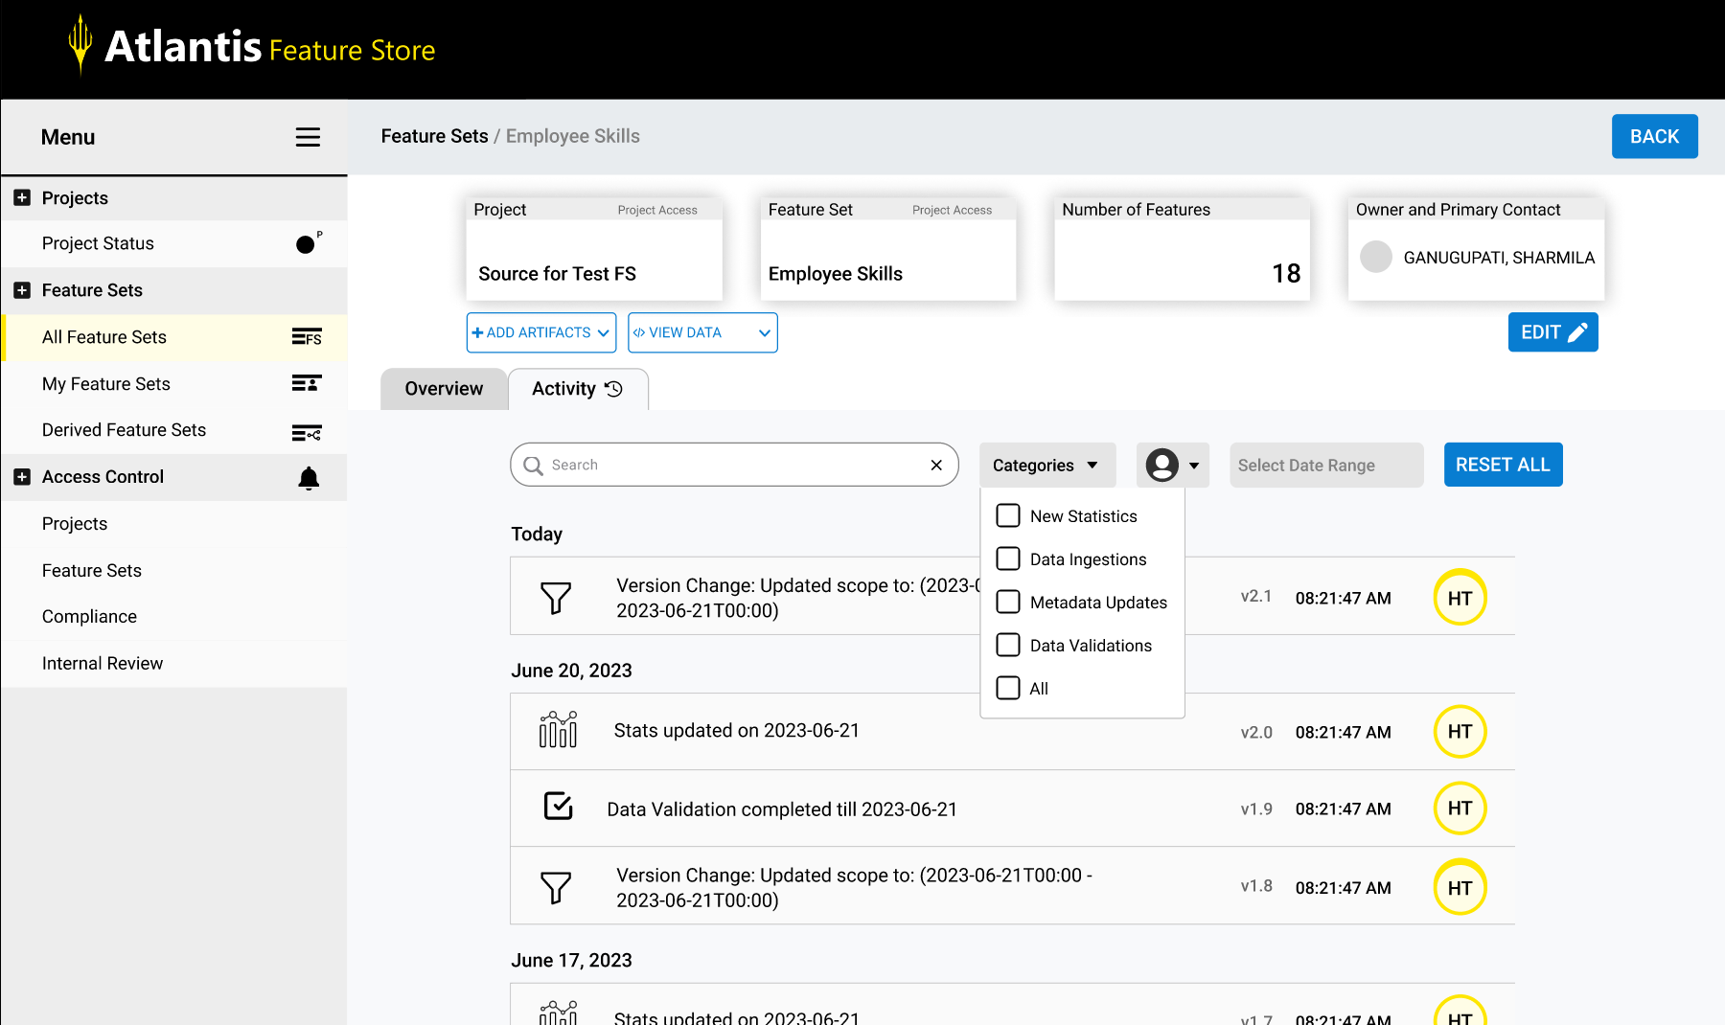
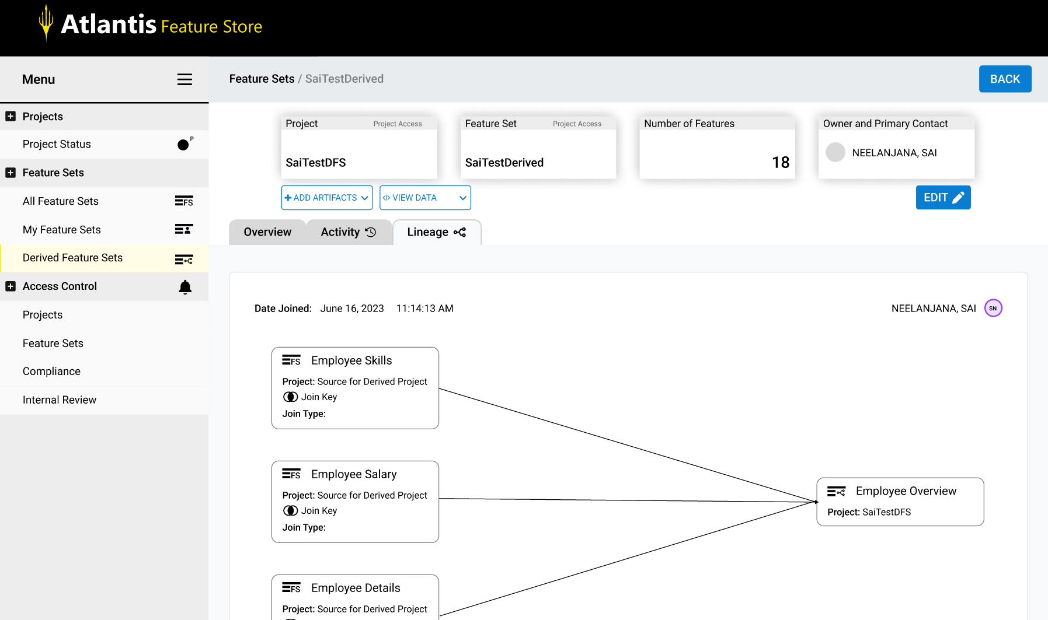
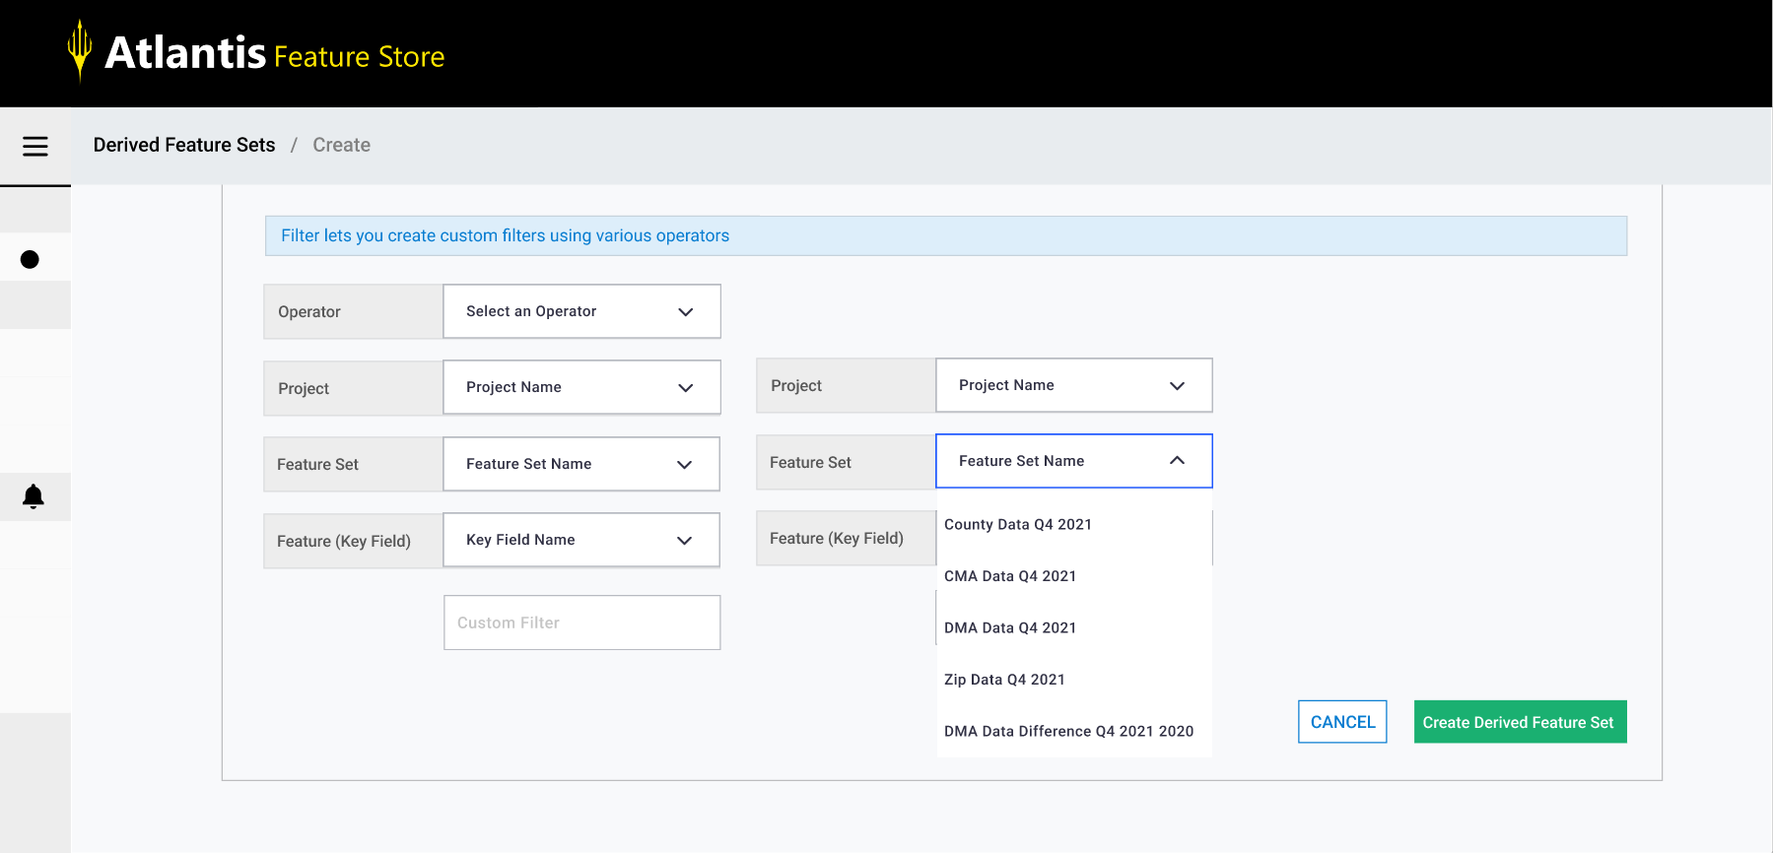
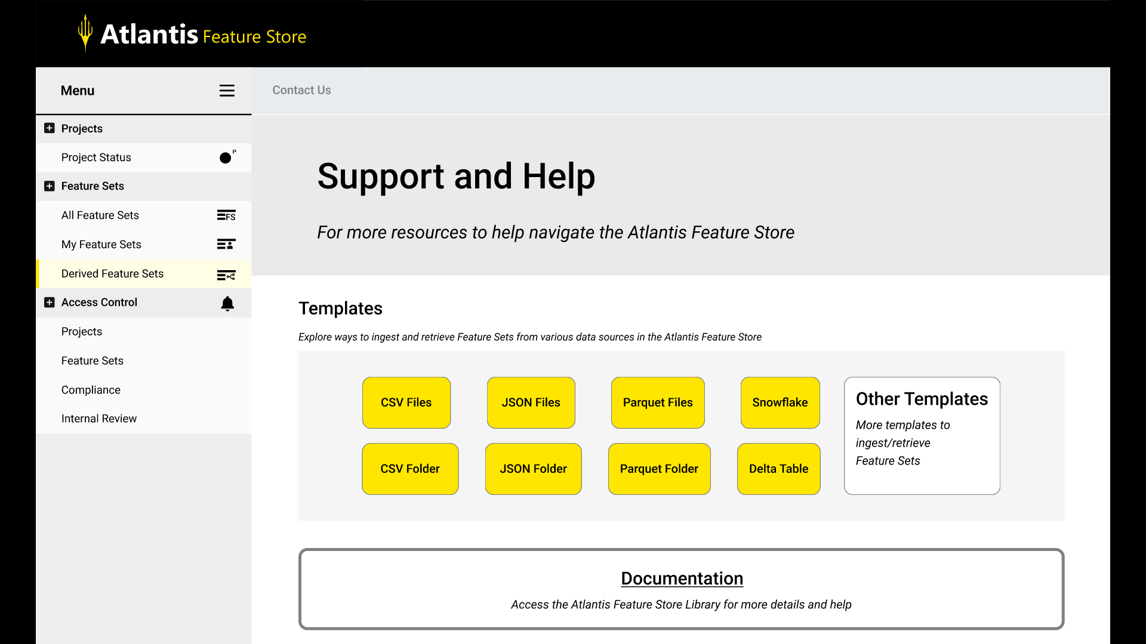
Activity and Lineage Page
Figma High Fidelity Prototypes
Custom Filter for Derived Feature Sets
Atlantis Feature Store Support Page

Slide 7
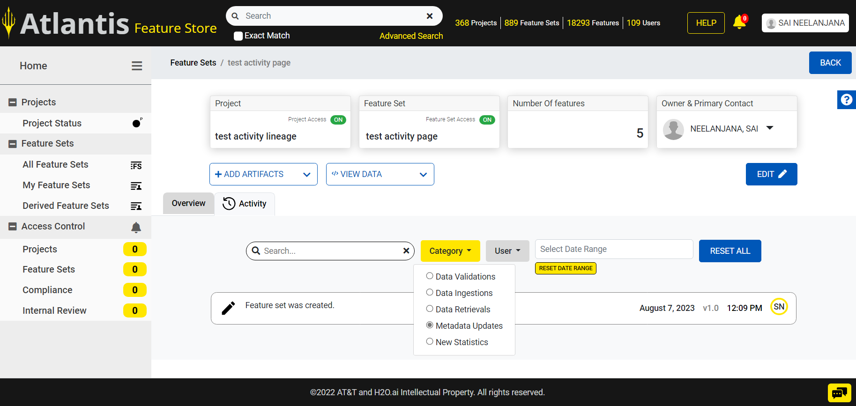
Activity and Lineage Page – Deployed in Dev Environment
Atlantis Feature Store Test FS Link
UI Front-End Development in Angular/HTML/CSS

Slide 8

TDP Accomplishments and Involvement
Workshops
Agile, Data Visualization, Software Engineering, Design Thinking
Intern Innovation Challenge
Worked on team S.T.A.R.S to design solution using AI to optimize emergency dispatch process
Took on the role of Scrum Master
Scheduled meetings, designed prototypes in Figma, and researched current solutions in place
TDP Events
Enjoyed learning more about the TDP program and AT&T culture from other employees and TDP full timers at following events
Girlstart fundraiser
Pop Culture Trivia
Power Hour with Angela Baskerville
Town Hall with John Stankey
All Hands Meeting
Feel Good Friday
Bowlero Networking Event
Converged Experience Tour
SOCO Olympics
PLE
Taking courses to study for the AZ-900 exam in order to earn the Microsoft Azure Fundamentals certification
RTO Volunteer
Handed out cards with workplace resources and greeted new hires and employees returning to office

Slide 9



​Project Conclusion
Effectively collaborated with Business Partner team to design, develop, and deploy new activity and lineage pages
Designed prototypes for two side projects
Made meaningful relationships with BP Team, AD, and fellow interns
​Future Work​
Improve search capabilities on the activity page
Introduce third layer to lineage page
Develop Atlantis Support Page with possible Ask AT&T integration
Continue developing skills in Data Analysis and Full-Stack Development
Major Takeaways​
Figma and UI design
Angular and HTML/CSS​
API Integration and Front-End Development​
Agile Scrum Methodology​
Effective communication and networking
Notes:
Developed expertise in the Angular framework and honed UI development skills.
Delved into the dynamics of Scrum teams and their collaborative methodologies.
Explored product development life cycle.
Enhanced proficiency in API integration and its practical applications in projects.
Expanded knowledge of industry tools and technologies through meetings and interactions with team members and fellow interns.
Built meaningful relationships with BP, AD, and fellow interns.
Enhance API to group activities by date.
Introduce a third layer to lineage page, displaying use of derived feature sets.
Improve search capabilities on the activity page for better user experience and efficiency.
Develop the support page, considering potential integration of AskAT&T for added value and assistance.
I would like to express my sincere thanks to my BP, Himanshu Tiwari; Mentor, Sharmila Ganugupati; AD, Mart Hoover; fellow interns; and the Atlantis Team for their invaluable guidance, support, and collaboration during my internship.

Slide 10

Special Thanks To...
Atlantis Team
(Himanshu, Krishna, Sharmila, Sushil)
AD Mart Hoover
IIC Team S.T.A.R.S
(Naren, Derek, Eric, Faisal)
TDP Interns
I would love to connect on LinkedIn ^_^ @sai-neelanjana

Slide 11
Appendix:
Figma High Fidelity Prototypes
GIFs and links to Figma designs
Project Deployed in Dev Environment
GIF and link to final product deployed in Dev Environment
Weekly Overview Slides 1-8
Slides detailing work done on a weekly basis
Presented to BP and another intern on the team during weekly sync up

Slide 12
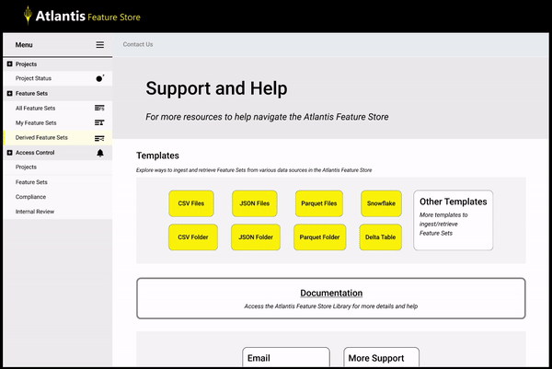
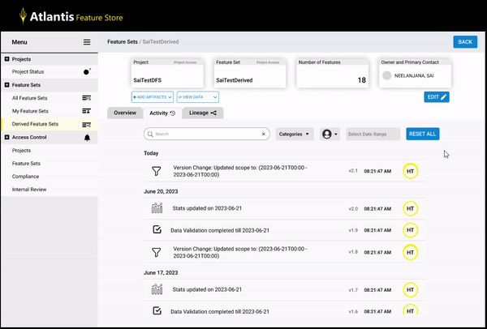
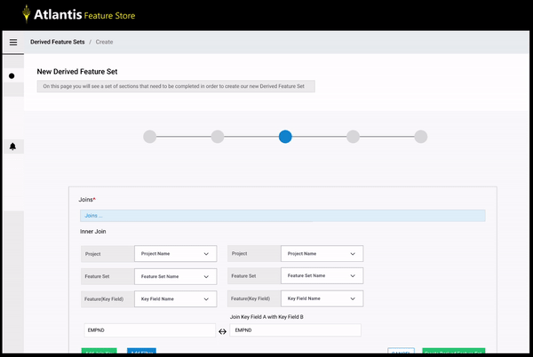
Atlantis Feature Store Support Page
Activity and Lineage Page
Figma Link
Custom Filter for Derived Feature Sets
Figma Link
Figma Link
Figma High Fidelity Prototypes

Slide 13
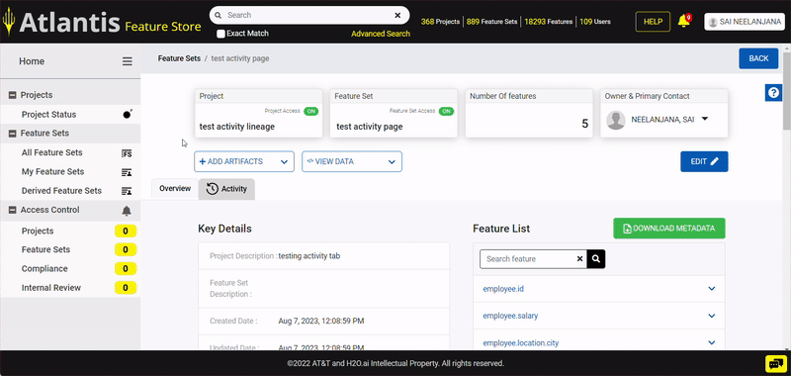
Activity and Lineage Page – Deployed in Dev Environment
Atlantis Feature Store Test FS Link
UI Front-End Development in Angular/HTML/CSS

Slide 14

Week 1 Overview
Onboarding
Setting up all AT&T systems
Meeting and connecting with other TDP interns and the ADs
Business Partner Assignment
Met with BP
Discussed what the team does
Joined Daily Scrum call and was introduced to team
Walkthrough of current UI Flow

Slide 15
Week 2 Overview
BP Assignment
Custom Filter high fidelity design in Figma
Discussed main assignment for internship
Create an Activity Page that logs useful information for Atlantis Feature Store Users
Create Lineage Page to help visualize how feature sets were combined
Designed paper prototypes for Activity and Lineage pages
Onboarding
Attended TDP workshops
Agile
Time Reporting
Benefits
Software Development
Intern Innovation Challenge
Attended Kickoff and learnt about challenge
Met with Intern team
Design Thinking Workshop
Started thinking about ideas
Scheduled daily call
​

Slide 16
Week 3 Overview
BP Assignment
Established Project Timeline
Designed High Fidelity prototype for Activity and Lineage pages in Figma
Intern Innovation Challenge
Started working on Design Thinking Workbook
Researched more about Emergency Medical Dispatch process
​

Slide 17
Week 4 Overview
BP Assignment
Established Project Timeline
Started weekly intern sync up to review accomplishments for the week
Continued to edit high fidelity design prototypes with iterative development and testing
Setting up system
Resolving proxy and host issues
Downloading node.js
Installing Angular framework
TDP
Q2 All Hands Meeting
Power Hour with Corporate Systems, VP, Angela Baskerville
Intern Innovation Challenge
Filled out Design Thinking Workbook
Drew up rough paper prototypes for design
​

Slide 18

Week 5 Overview
Angular
Reviewing Bootstrap templates
Implementing Tab functionality
Exploring parent/child component interactions
Previewing design changes in local host
Setting up system
Resolving proxy and host issues
Downloading node.js
Installing Angular framework
Codebase
Cloning repo to local machine
Creating personal branch
Getting familiar with codebase
Intern Innovation Challenge
Using AI/openAI to create a business solution for AT&T customers
Created low fidelity prototypes in figma
​
Leveraging AI to support dispatchers, EMTs, and hospitals in emergency medical dispatch procedures, so that we achieve rapid response times, improved patient outcomes, and efficient resource utilization?

Slide 19
Week 6 Overview
UI Development
Created component for each activity update
Created component for lineage info boxes as well
Made layouts for all elements flex responsive using media queries
Researched how to create graph lines in CSS/HTML
LeaderLine
jQuery Plugin
TreeFlex
Explored how an API works
Displaying information from API response JSON in UI
Implementing Search/Filter bar in Activity tab
Added dropdowns for Categories and User
Researched designs for Atlantis Support Page
Intern Innovation Challenge
Patent paperwork for design solution
Design Thinking Workbook
Understanding how FirstNet works
CIO Q2 Town Hall with John Stankey
August 9th, 11:05 AM, Teams Meeting link closer to date
​

Slide 20
Week 7 Overview
UI Development
Designed High Fidelity prototype for Atlantis Support Page in Figma
Internal team demo for support page
Support Page Demo with BP and Director of Technology
Integrated API with UI to display activities logged in the backend
Modified code for activity filters to work with API
Intern Innovation Challenge
Final presentation slide deck
Created user flow for Design Thinking Workbook
August 9th, 11:05 AM, Teams Meeting link closer to date
​

Slide 21
Week 8 Overview
UI Development
Implemented Pagination
Deployed Activity Page to Stage environment
Testing UI in Stage environment
Internal team demo for Activity Page
Constant communication with backend to look into API responses and layout
Added new Activity Category, Data Retrievals, and included in dropdown filter with new icon
Changed icons for Data Ingestions
Added “No activity found”
Changed layout of each activity update to use bootstrap flex layout
Intern Innovation Challenge
Local Demo to ADs
Created a video to pitch product
Submitted all deliverables on July 26th
Converged Experience Tour
Learned about how AT&T Fiber works on a high level and how it is installed
August 9th, 11:05 AM, Teams Meeting link closer to date
​

